Slide 1
Lesson 1.1
Marketing and the Marketing Concept

Slide 2
Marketing and the Marketing Concept
  Objectives
  Define marketing
  Three things you must follow in marketing
  Three Types of Products
  List the seven functions of marketing
  Understand the marketing concept
Marketing Essentials Chapter 1, Section 1.1

Slide 3
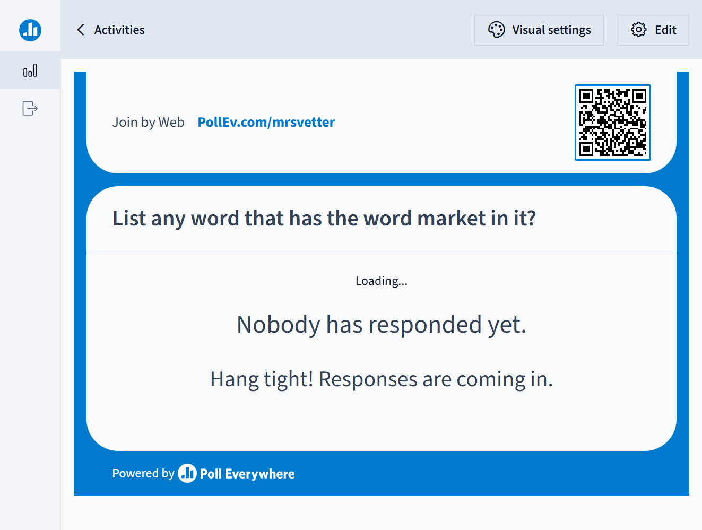

Slide 4
What is a Market
Based on these Words: What is going on in a Market?
A market is a place where we buy, sell or exchange something (for money or no money)
What goes on:
Buying
Selling
Trading
Exchanging
Bartering

Slide 5

How Do You Know?
You have a booth at the Farmer’s Market and you are selling items you made on your 3D Printer.
Ask Your Neighbor – How do You know what I am selling, trading, exchanging, or bartering
What goes on:
Signs
Ads
Sales Person
Social Media
YouTube

Slide 6
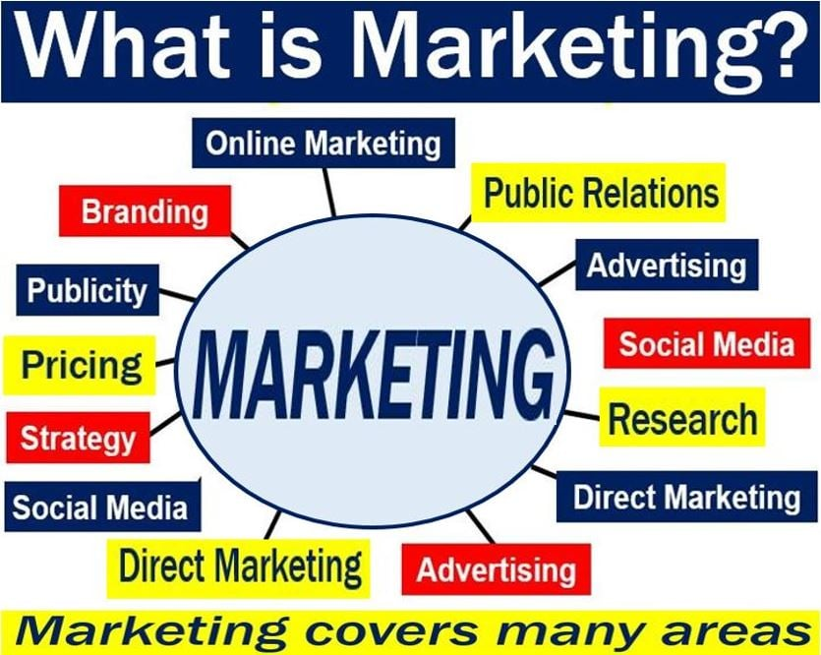
What is Marketing?
Marketing: The process by which goods and services move from a concept (idea) to the customer.
It includes the processes of planning, pricing, promoting, selling, and distributing products that satisfy customers’ needs and wants.
In Layman's Terms: Marketing is everything we do to get the product to the markets!

Slide 7
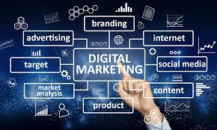
Marketing is:
  Marketing is a process = ongoing and changes always
  Is always about and directed towards
  the customer

Slide 8
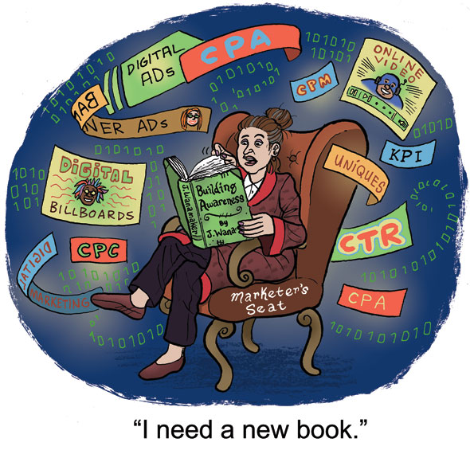

Marketers MUST Keep up with:
  Trends - start selling what is the hot new items that people want
    What is hot in the car industry?
    What is hot in the food industry?
    Ecommerce – selling online
  Consumer Attitudes - Support what people believe and support
    Reduce the Environmental Impact
    Family First Movement
    Remote Work (working from home)
    The NFL & Social injustice (Nike & Colin
    Kapernik, Budlight Fiascal
  Customer Relationships –
  implement something that gets
  customers to come back and buy again
  or get their friends to come in
      Loyalty Programs are huge
      Service
      Quality
      Customer Service Will Need To Be
      Personalized and Empathetic
Marketing Essentials Chapter 1, Section 1.1

Slide 9

75% are likely to start shopping at a company that supports an issue they agree with
59% are likely to stop shopping at a company that supports an issue they disagree with.

Slide 10

Assignment
Complete “What is Marketing” on Google Classroom

Slide 11
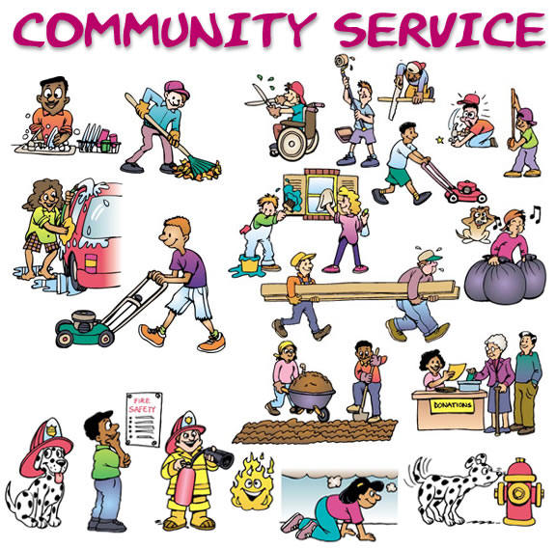
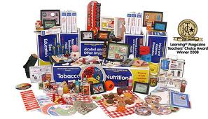
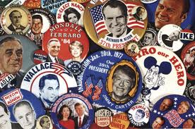
Three types of Products
Marketers sell products that people want and need
Three types of products can be marketed
  Goods
  Services
  Ideas

Slide 12
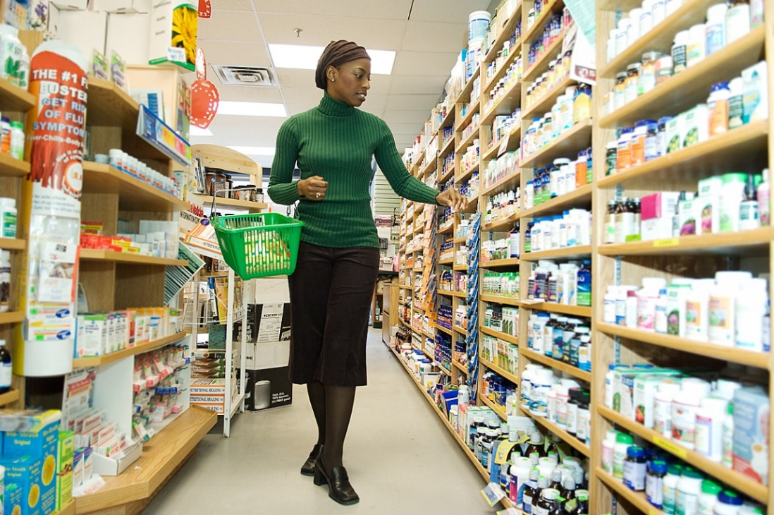
  1. Goods : tangible items of monetary value (we can sell, buy, or trade) that satisfy customer needs and wants:
  List 3 examples of goods in your notes:
  Examples of marketed goods X include:
  Home furnishings
  Cars
  Electronics
  Food

Slide 13
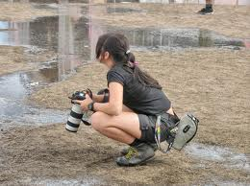
2. Services: Intangible (can’t touch) items of monetary value (pay someone to do it for you) that satisfy customer needs & wants
List 3 examples of services in your notes:
Examples of services X that may be marketed are:
  Automotive repair
  Hair styling
  Legal aid
  Financial consulting
  Education
  Entertainment

Slide 14
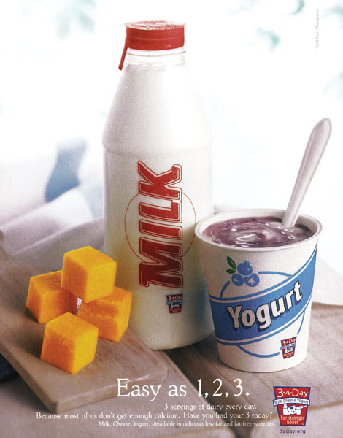
What does this ad make you think?
What is being sold?
- No brand, no specific product
- Not selling an economic good/service
This ad promotes the idea of a healthy diet that includes dairy products

Slide 15
Ideas: an opinion, view, or belief
- can’t be sold, but will try to get you to believe it through marketing
  List three types of ideas in your notes:
  Examples of ideas that might be marketed are:
  A candidate’s political platform
  A public service initiative, such as don’t text and drive, don’t smoke or stay in school

Slide 16
Economic Products
Economic means money is exchanged.
  It is economic because when people spend money, and economy is strong, if they are not, an economy is week and going through a recession
Of the three types of Products, Goods, services, and ideas, which are Economic?
  Goods and Services

Slide 17
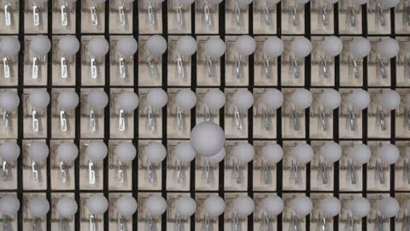
What is being Marketed?

Slide 18
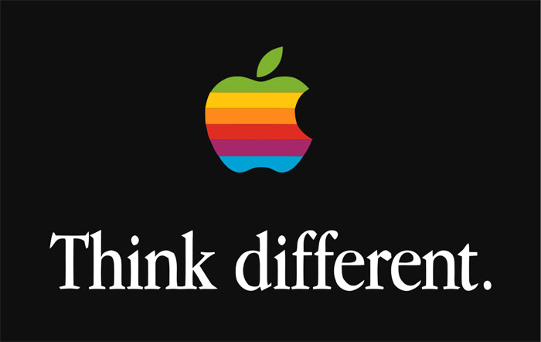
Is this a Good, Service, or Idea?
Is there a Brand Identified?
If yes a brand it isn’t marketing an idea.
Is the brand something you own that is tangible? IF so it is a good. Or are you payin them to do it for you? Then a Service

Slide 19
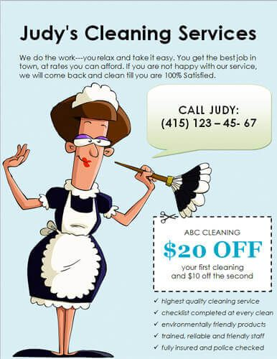
Is this a good, Service, or Idea?

Slide 20

Is this a good, Service, or Idea?

Slide 21


Slide 22
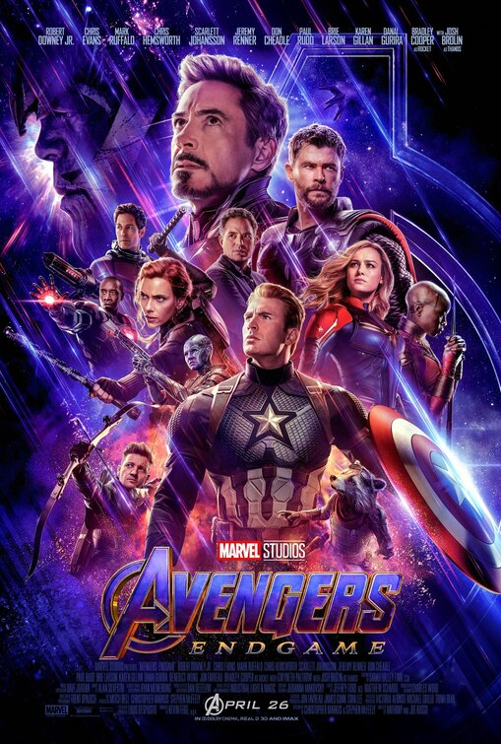


Slide 23
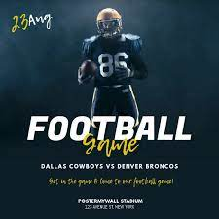

Slide 24
Assignment
Complete the Classmarker Worksheet: Is it a Good, Service or Idea questions. This is not a test, you can use your notes.

Slide 25

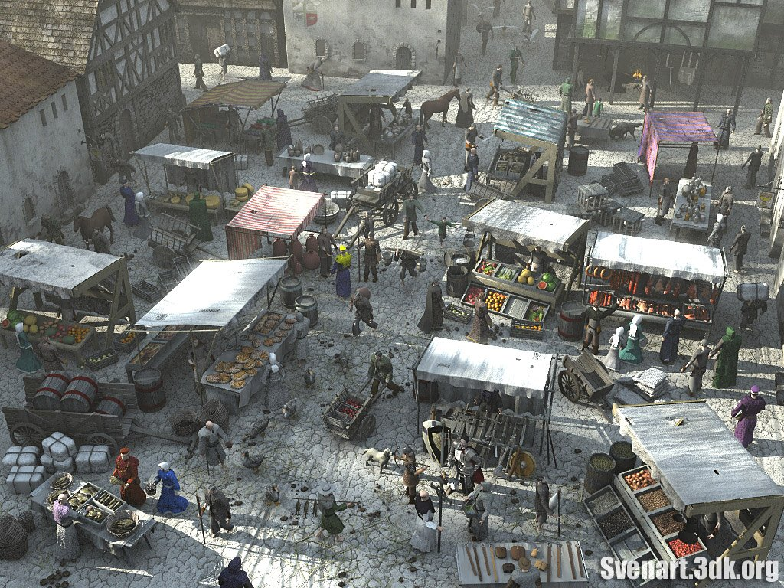
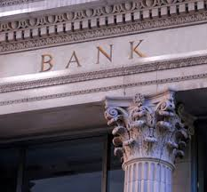
Three Types of Marketplaces
The marketplace is the commercial environment in which buying and selling (or exchanges) take place.
What are examples of marketplaces:
  Shops (brick & mortar)
  Internet stores
  Financial institutions
Marketing Essentials Chapter 1, Section 1.1

Slide 26
Keeping them straight?
The marketplace is the commercial environment in which buying and selling (or exchanges) take place
Marketing: The management process by which goods and services move from concept to the customer. It includes the processes of planning, pricing, promoting, selling, and distributing products that satisfy customers’ needs and wants.
Marketing is everything we do to get the product to the markets!

Slide 27

Seven Functions of Marketing
Market Planning
develop new strategies or initiatives that target specific markets or a select audience
  Create a plan that targets a specific market or select audience
    i.e. new product for
    people that scuba dive

Slide 28

Seven Functions of Marketing
2. Marketing information management gather, and analyze information on customers, trends, and competitor products
research and survey on customer habits, attitudes, where live, and marketplace trends
This information is then
used in market planning
in new initiatives and
business activities
        continued

Slide 29

Think about it
From a survey of customers, your data shows that 10% feel you have excellent service, 80% feel it is average, and 10% believe it is poor. What do you do?

Slide 30
Seven Functions of Marketing
  Channel Management (Distribution) - the process of making a product or service available for the consumer or business user that needs it.
  How can you get your goods to customers?
  Moving - air, trains, trucks, ship
  Via the internet (downloads, streaming, email etc.)
  Storage – Some companies store in local or regional warehouses, then ship to retailers
Marketing Essentials Chapter 1, Section 1.1

Slide 31
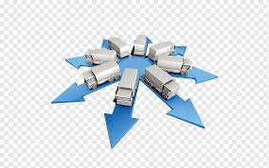
Structure of Channel management
The basic structure of your channels such as:
producer → wholesaler → retailer → customer
producer → retailer → customer
producer → customer

Slide 32
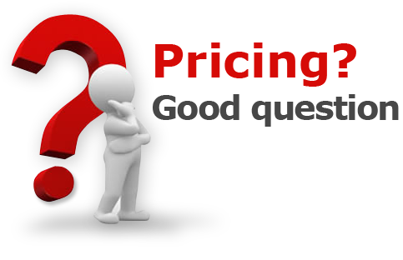
Seven Functions of Marketing
Can you just create a product, slap any old price on it, and expect everyone to buy it?
Pricing what you charge for goods and services to make a profit
  initial and sales price decisions
    What are customer’s willing to pay
    What is the competition charging

Slide 33
Seven Functions of Marketing
Product/service management
create, maintain, or improving a product or service that customers want and need
    Create new products or remove old products from the market
    Upgrade, and improve your existing products
    Upgrade & improve your processes
  Name a product you own that has been updated with new features that you want/bought the new version?
i.e. cell phones, i-pods, software, etc…
Do things better, faster, and more efficiently than the competition!

Slide 34

Seven Functions of Marketing
6. Promotion informing, persuading, and reminding customers about a product or service through indirect (not face to face) channels.
Examples:
    TV, Radio
    Social Media
    Pop-up menus ads on apps
    Phone calls
    Mail and e-mail
    Loyalty Programs

Slide 35

Seven Functions of Marketing
Selling persuading your customers to purchase your products through face to face personalized communication
- uses product features and benefits to convince customers to want your goods or services
- sales aids, sales presentations,
demonstrations etc.

Slide 36
Seven Functions of Marketing Practice Assignment
Go to Google Classroom and complete the Seven Functions Marketing Practice Assignment

Slide 37
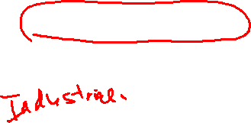
Focus of 7 Functions:
What has been the main focus of each of our 7 functions of Marketing?
  Customers
  What are their wants and needs!!!!
The Sevan Steps of Marketing are directed at
Two Types of Customers
Consumer Direct – selling to you the customers in retail markets (stores, door to door & internet) – sales person
Business to Business – markets of customers that include Wholesalers, retailers, or manufactures

Slide 38

The Marketing Concept
  Video (play through 1.40) Click video below. If this does not work, click this link to play video
Marketing Essentials Chapter 1, Section 1.1
Notes:
What is marketing: exploring, creating, and delivering value to satisfy the needs of a target market at a profit.
What is the hidden word in the marketing definition?
Competitor

Slide 39
What is the hidden word in the marketing concept definition?

Slide 40
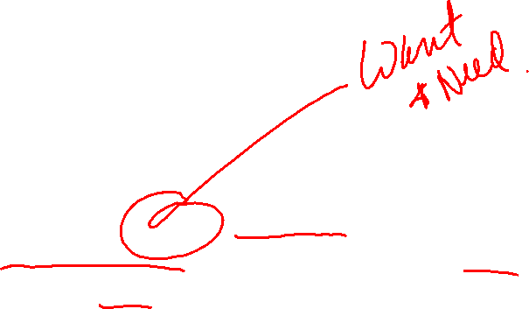
The Marketing Concept
The marketing concept X is the idea that a business should provide value different than competitors to satisfying the needs and wants of customers at a profit
Marketing Essentials Chapter 1, Section 1.1
Notes:
What is marketing: exploring, creating, and delivering value to satisfy the needs of a target market at a profit.
What is the hidden word in the marketing definition?
Competitor

Slide 41
Marketing and the Marketing Concept
Study Organizer
What are 3 types of products?
What are 3 things you should keep up with as a marketer?
What is an Example of Selling
What is an Example of Promotion?

